Slide 1

Atlanta ContactPoint
Empowering you to play
Presentation
MARCH 2013

Slide 2
ENVIRONMENT | The Background
growing problems of
inactivity
virtual play
poor nutrition
information overload
superficial connection
insufficient green space

Slide 3
ENVIRONMENT | The Background
with a need to increase
physical activity rates
community education initiatives
access to green space
a sense of social & environmental responsibility
team-building efforts
capacity development & communications skills

Slide 4

Who We Are
Atlanta ContactPoint (ACP) is a Georgia 501(c)(3) non­profit organization established in 2012 to engage children and adults through the power of play.
Our mission is to create community-based models to support, educate, and facilitate comprehensive education and wellness programs that encompass sports, fitness, arts, nutrition, education, and social/environmental responsibility.

Slide 5

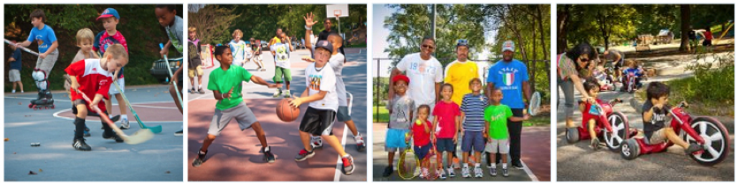
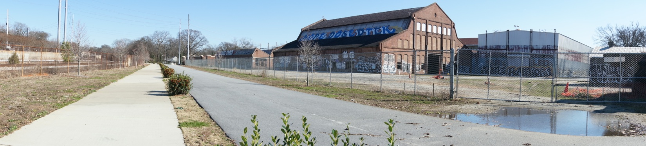
What We Do
PlayDay
The Pullman Yard Project

Slide 6
What We Do
PlayDay
A series of events which offer communities a free day to enjoy various sports, fitness, arts, nutrition and social awareness based programs. Play Day is the mobile version of our Pullman Yard model.
Pullman Yard
An indoor and outdoor community-based recreation space and trans-disciplinary center where children and adults of all socio-economic backgrounds will come together to play, learn, and connect.

Slide 7
What We Do
PlayDay We utilize existing city parks to bring together local neighborhoods and to promote their facilities, organizations, initiatives, and local coaches through the power of play.
PlayDay also engages participants in health initiatives, educating them on the importance of nutritious eating and environmental/social responsibility

Slide 8
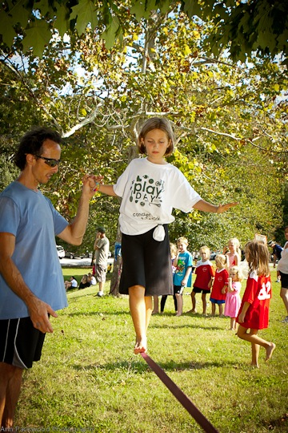

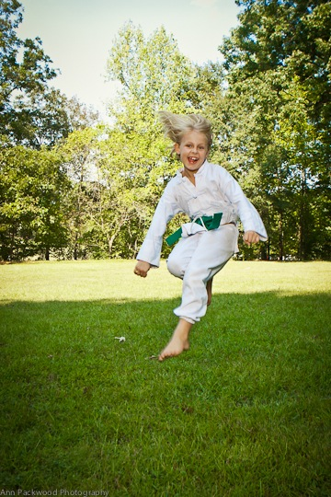
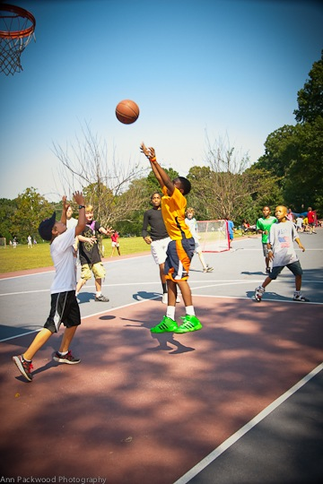
PlayDay Happiness

Slide 9
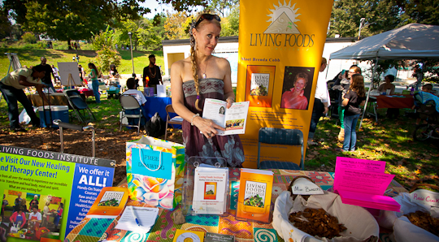
Play Day Health

Slide 10
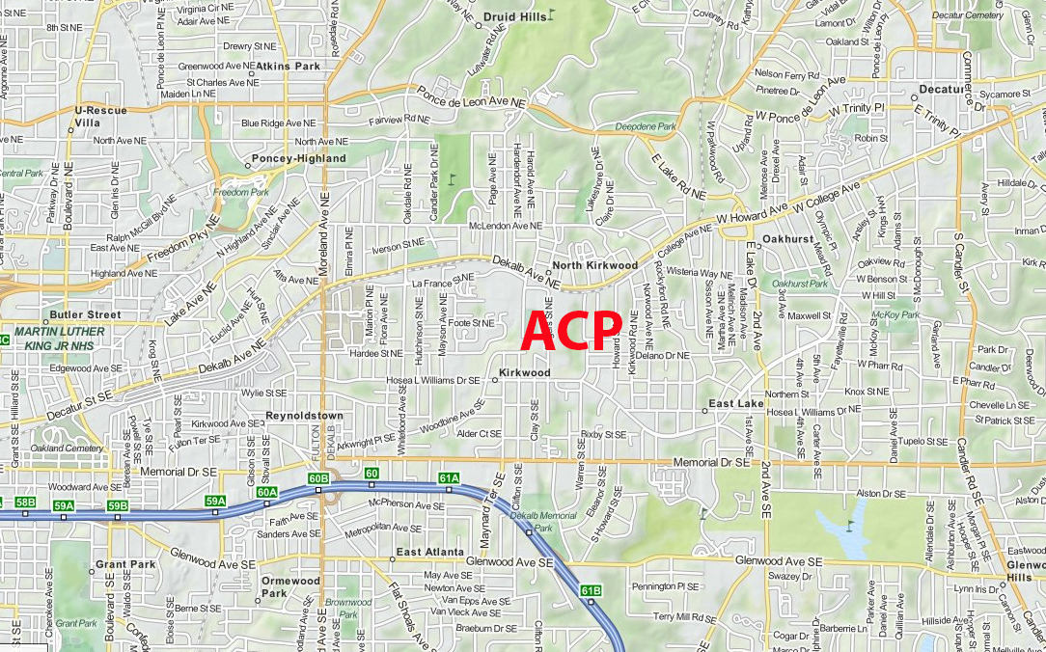
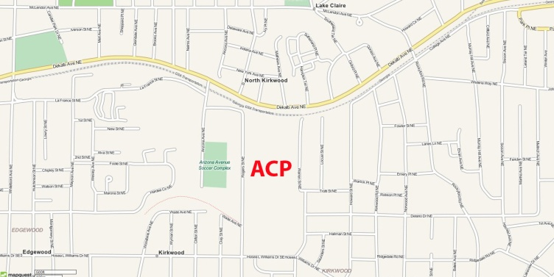
ContactPoint at Pullman Yard
Pullman Yard is a vacant 26-acre historic train yard that houses150,000 sq feet of buildings and is strategically located in the heart of Kirkwood, between Downtown Atlanta and the City of Decatur.

Slide 11
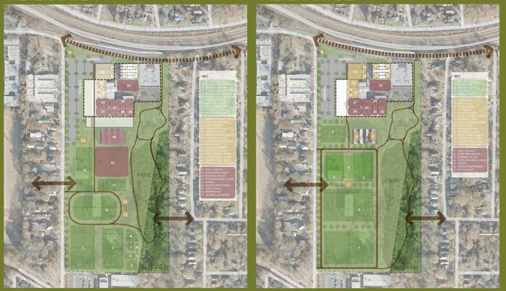
ContactPoint at Pullman Yard

Slide 12
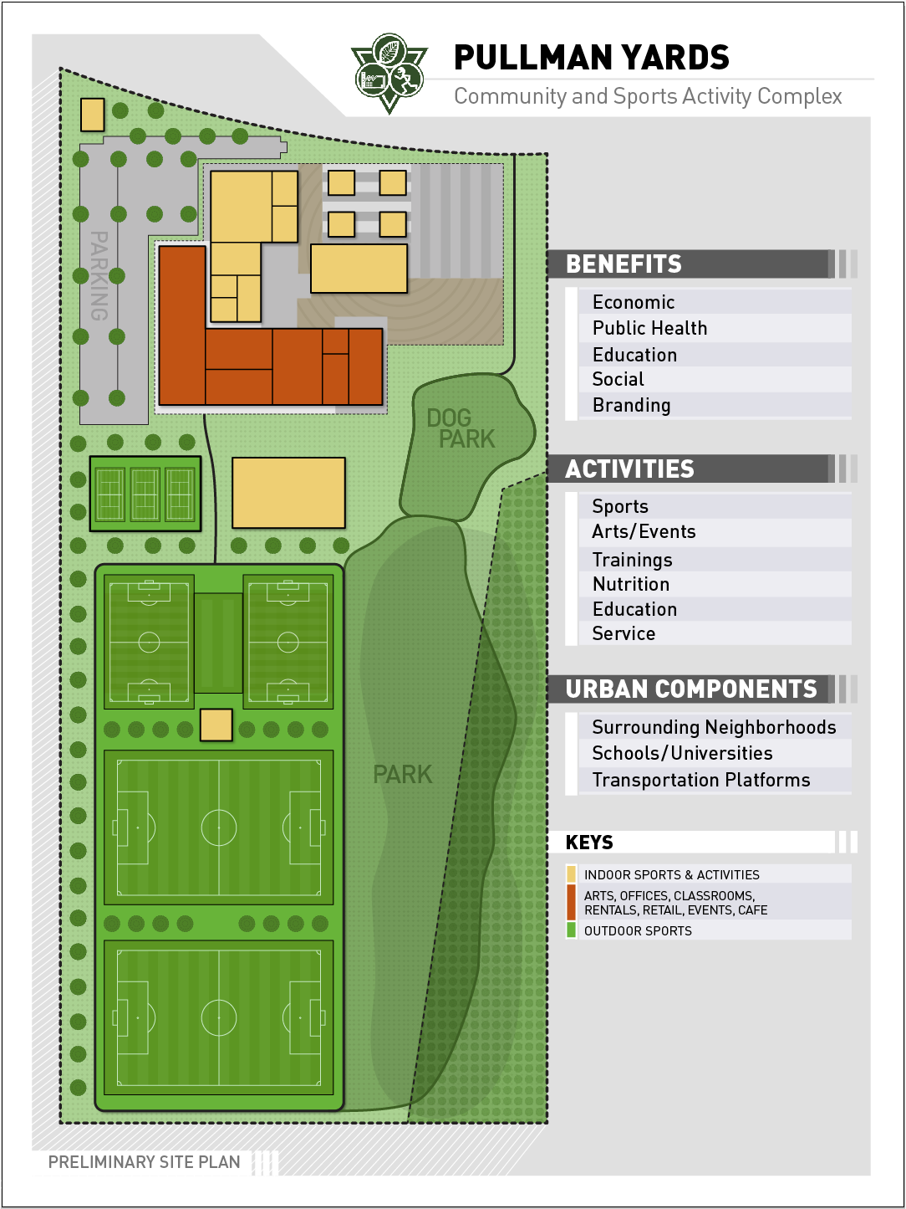
ContactPoint at Pullman Yard

Slide 13
ContactPoint at Pullman Yard
Pullman Yard means… achieving multiple benefits
Land Conservation | Historic Preservation
Sustainability | Alternative Transportation
Community Building | Job Creation
Education | Cultural Enrichment
Sports | Nutrition | Public Health
Kirkwood DT Business Enhancement | Security

Slide 14
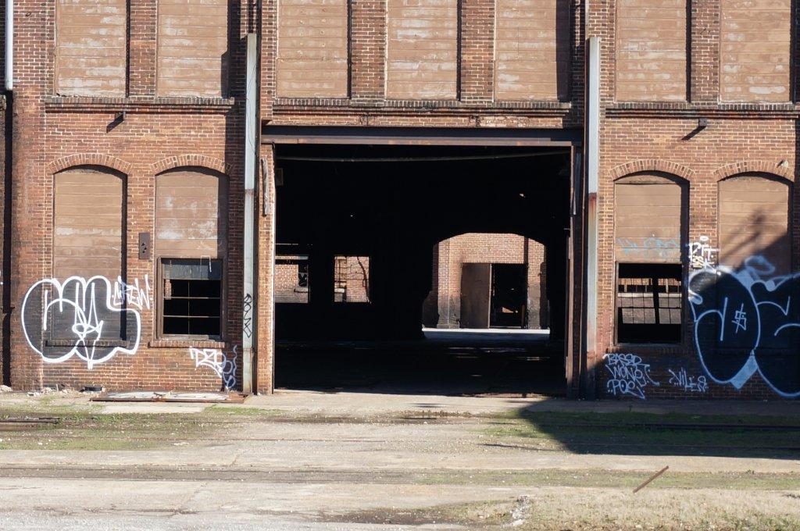
ContactPoint at Pullman Yard
Pullman Yard means … envisioning the potential

Slide 15
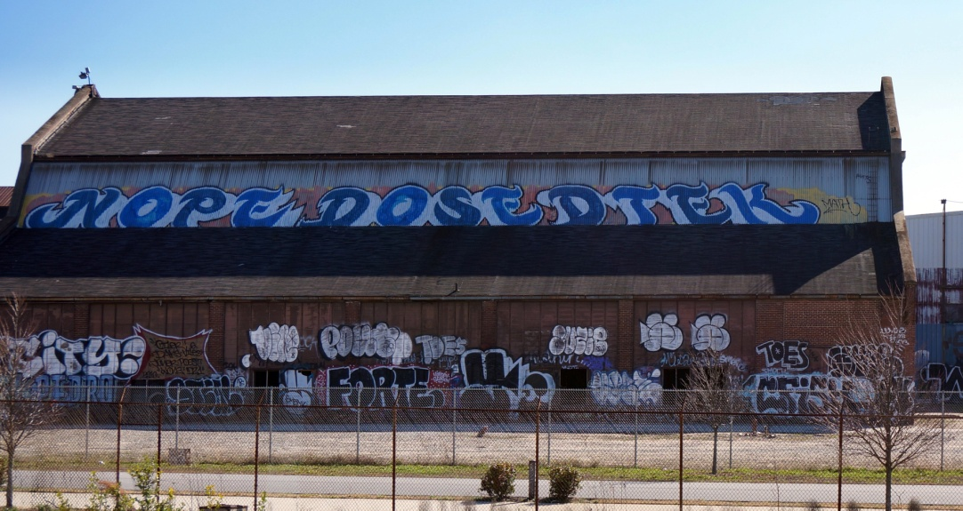
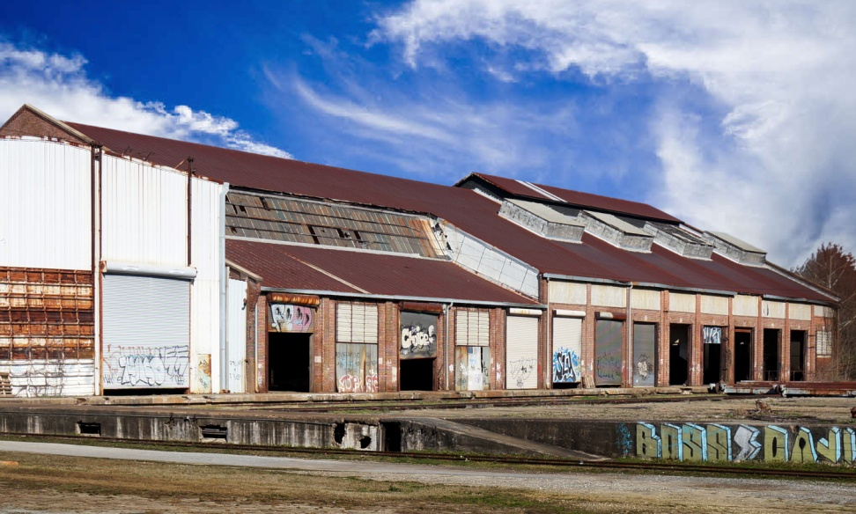
How We Do It
ContactPoint at Pullman Yard means …

Slide 16
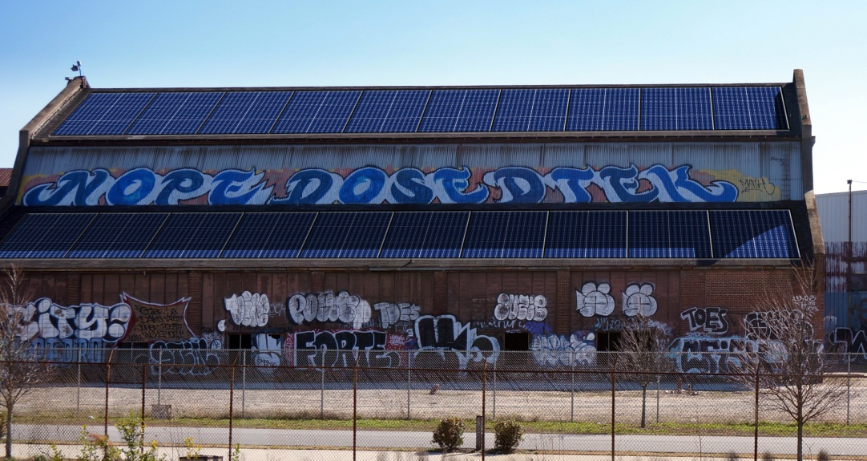
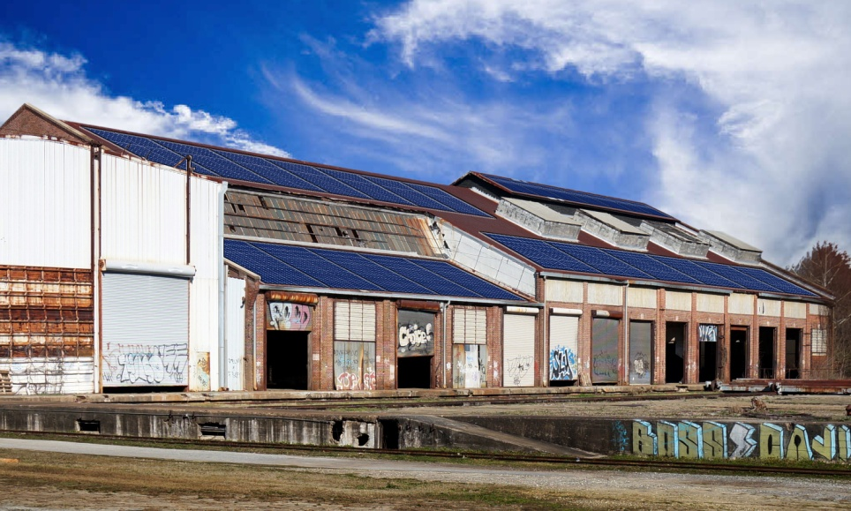
How We Do It
ContactPoint at Pullman Yard means … sustainability

Slide 17
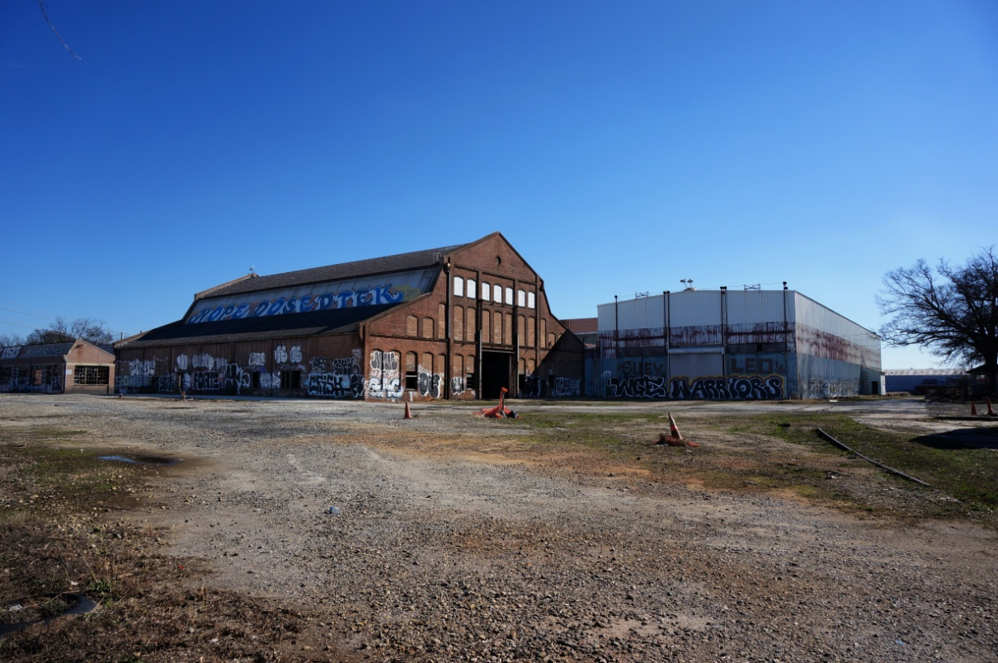
How We Do It
ContactPoint at Pullman Yard means …

Slide 18
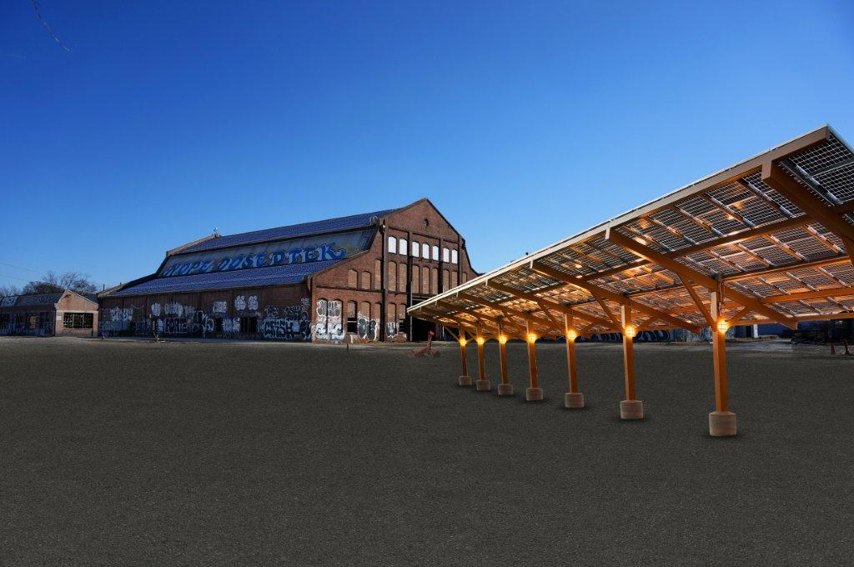
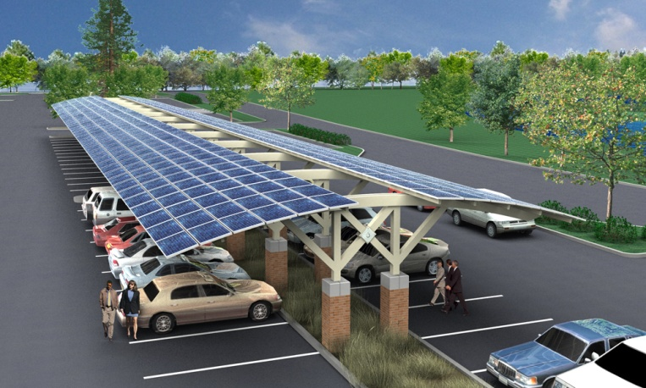
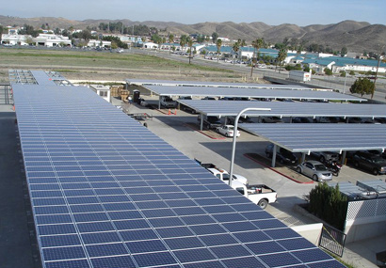
How We Do It
ContactPoint at Pullman Yard means … innovation

Slide 19
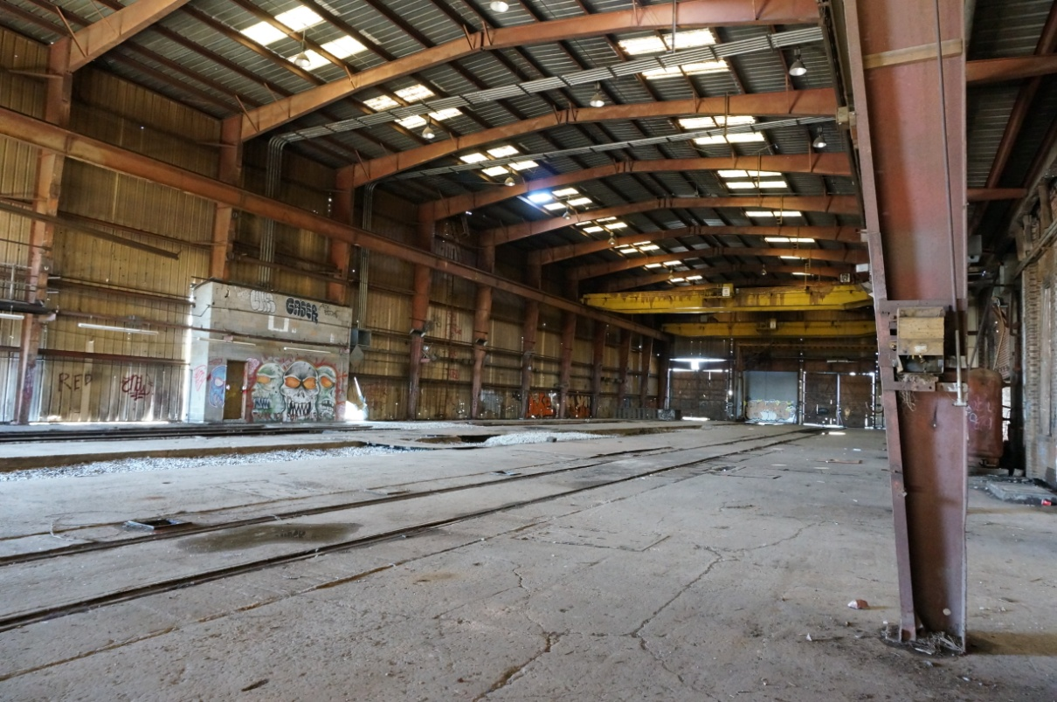
How We Do It
ContactPoint at Pullman Yard means …

Slide 20
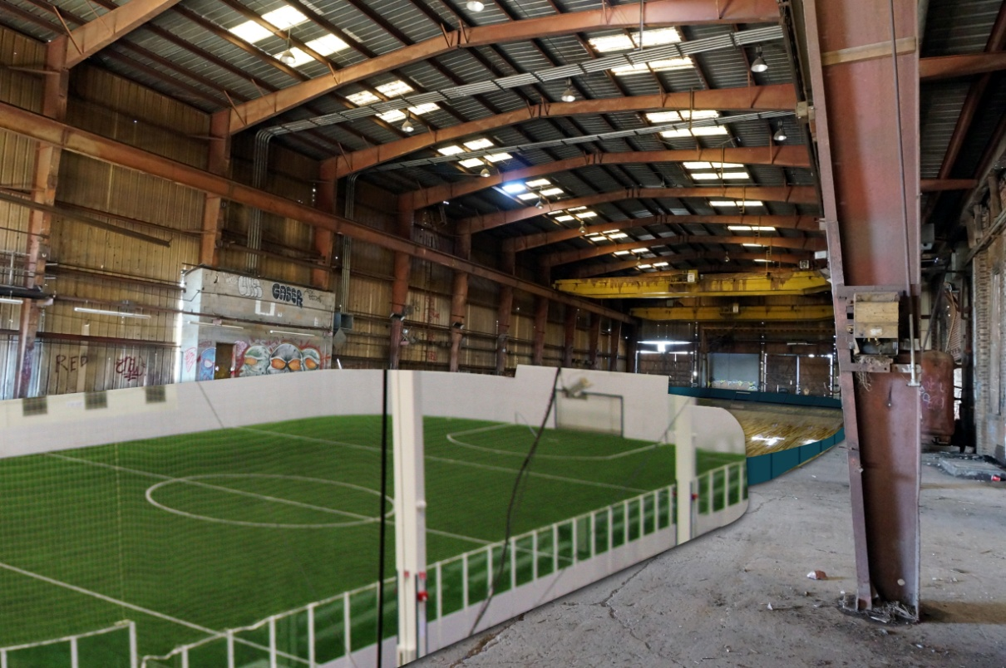
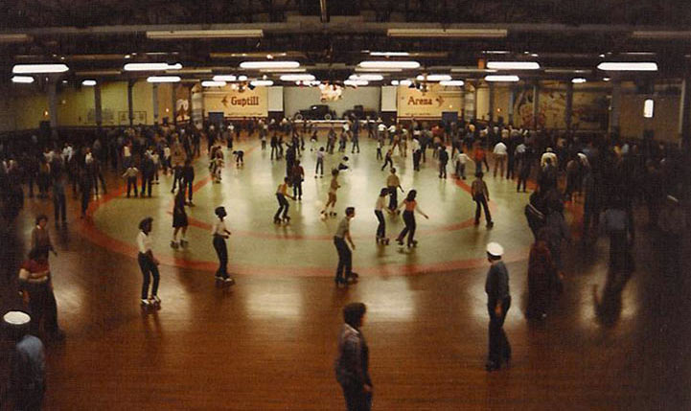
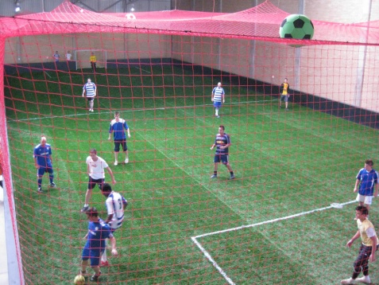
How We Do It
ContactPoint at Pullman Yard means … re-purposing with care

Slide 21
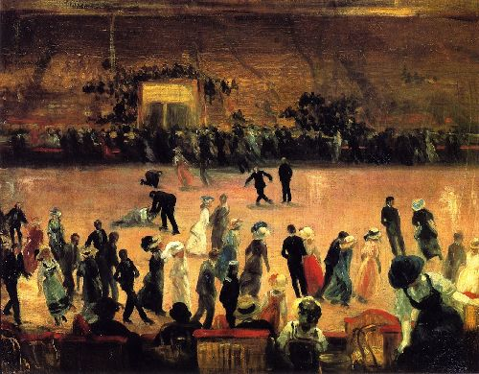
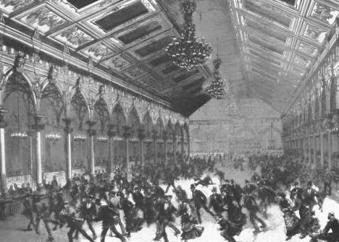
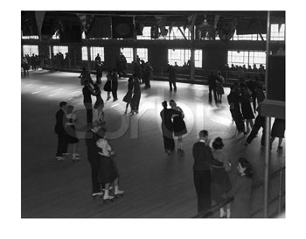
How We Do It
ContactPoint at Pullman Yard means reconnecting with values

Slide 22
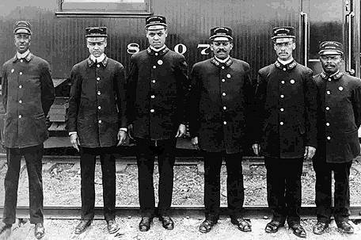
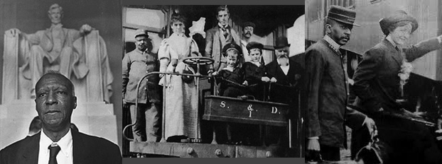

How We Do It
ContactPoint at Pullman Yard means reconnecting with history

Slide 23
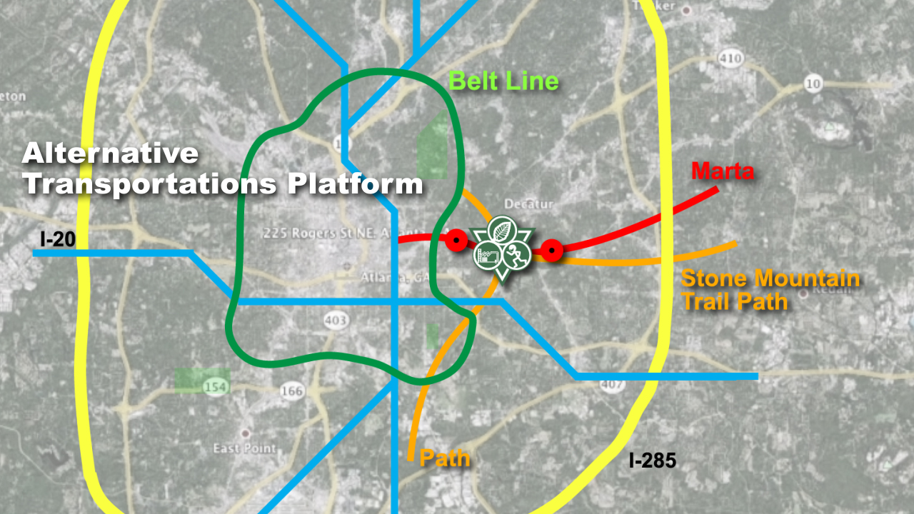
How We Do It
ContactPoint at Pullman Yard means smart transportation platform

Slide 24
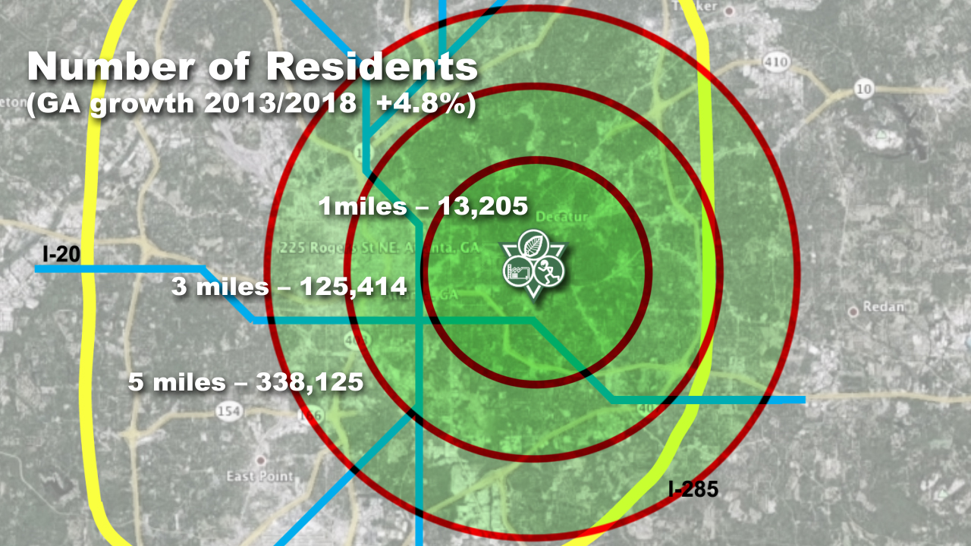
How We Do It
ContactPoint at Pullman Yard means a solid business plan, and a smart city development model also elsewhere reproducible.

Slide 25
How We Do It
Our non-profit will host versatile programming both day and night. This will allow us to create revenue while also addressing unmet social needs in the Kirkwood area.
100% of our proceeds will go directly to running the day-to-day operations of ACP and toward our mission of supporting the community with other like-minded initiatives.

