Slide 1
Atlanta ContactPoint Empowering you to play
Presentation for
March 25, 2013

Slide 2
ENVIRONMENT | The Background
growing problems of
inactivity
virtual play
poor nutrition
information overload
superficial connection
insufficient green space

Slide 3
ENVIRONMENT | The Background
with a need to increase
physical activity rates
community education initiatives
access to green space
a sense of social & environmental responsibility
team-building efforts
capacity development & communications skills

Slide 4
Who We Are
Atlanta ContactPoint (ACP) is a Georgia 501(c)(3) non­profit organization established in 2012 to engage children and adults through the power of play.
Our mission is to create community-based models to support, educate, and facilitate comprehensive education and wellness programs that encompass sports, fitness, arts, nutrition, and social/environmental responsibility.

Slide 5
What We Do
PlayDay
The Pullman Yard Project

Slide 6
What We Do
PlayDay
A series of events which offer communities a free day to enjoy various sports, fitness, arts, nutrition and social awareness based programs.
Pullman Yard
An indoor and outdoor community-based recreation space where children and adults of all socio-economic backgrounds will come together to play, learn, and connect.

Slide 7
What We Do
PlayDay utilizes existing city parks to bring together local neighborhoods and to promote their facilities, organizations, initiatives, and local coaches through the power of play.
PlayDay also engages participants in health initiatives, educating them on the importance of nutritious eating and environmental/social responsibility

Slide 8
PlayDay Tennis

Slide 9
PlayDay Tumbling

Slide 10
Play Day Hockey

Slide 11
Play Day Health

Slide 12
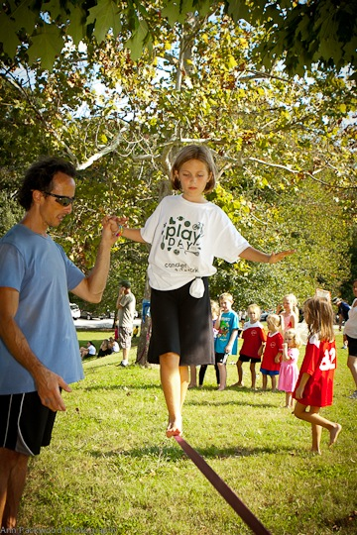
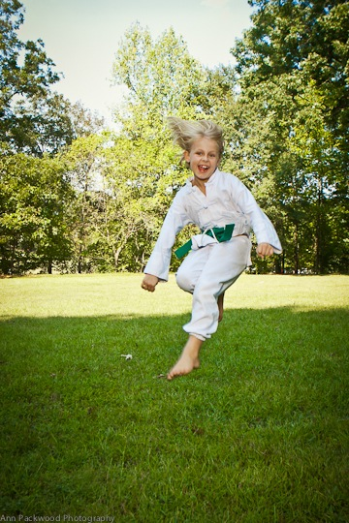
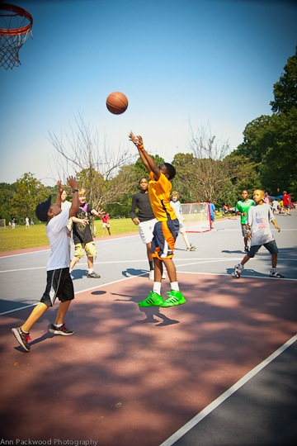
PlayDay Happiness

Slide 13
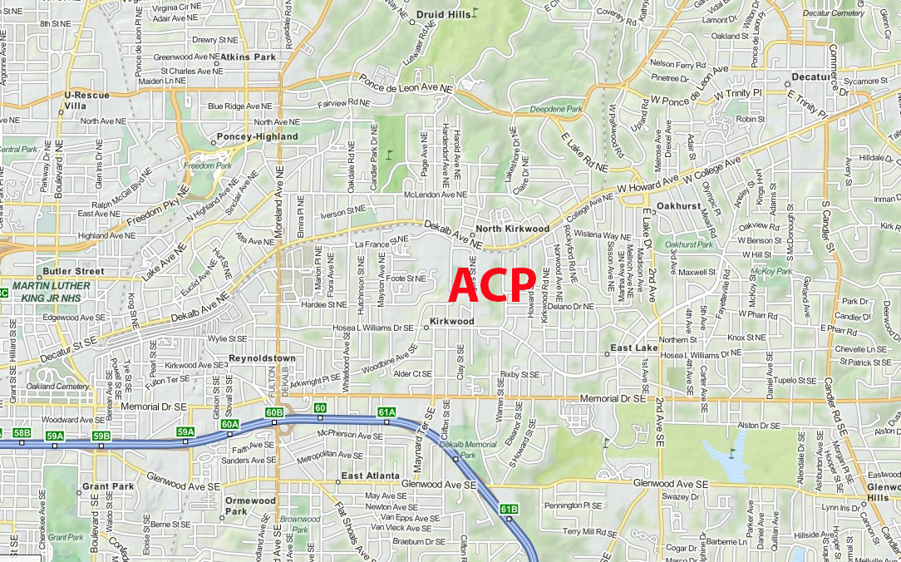
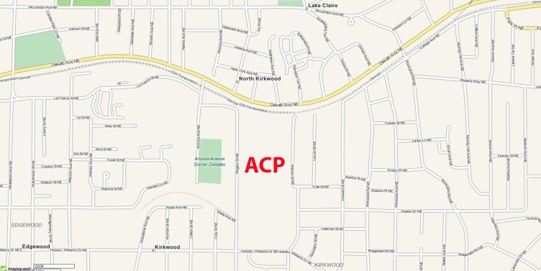
ContactPoint at Pullman Yard
Pullman Yard is a vacant 26-acre historic train yard that houses180,000 sq feet of buildings and is strategically located in the heart of Kirkwood, between Downtown Atlanta and the City of Decatur.

Slide 14
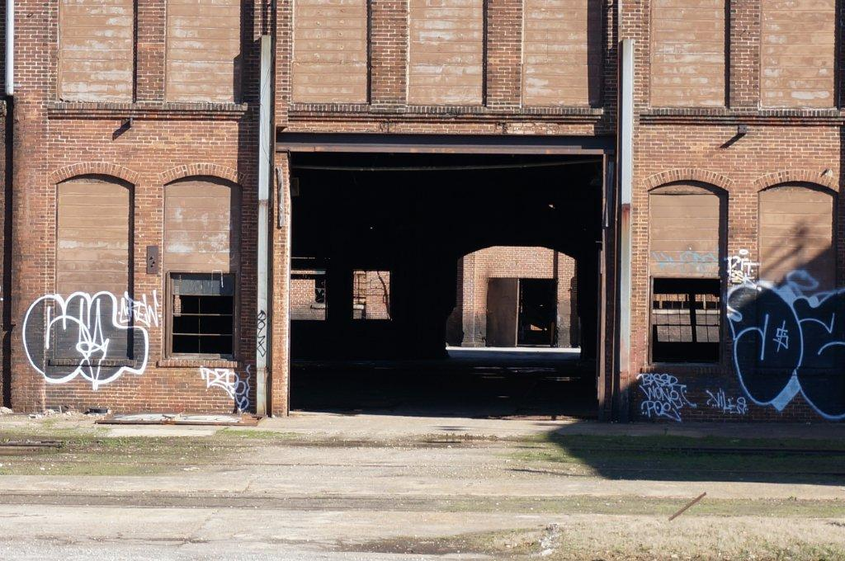
ContactPoint at Pullman Yard
Pullman Yard means … envisioning the potential

Slide 15
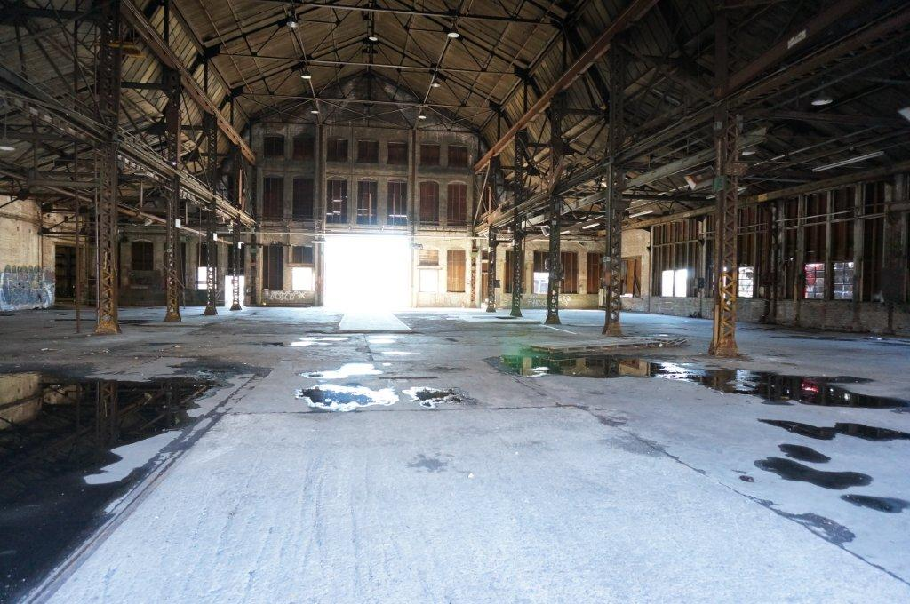
ContactPoint at Pullman Yard
to create community spaces…

Slide 16
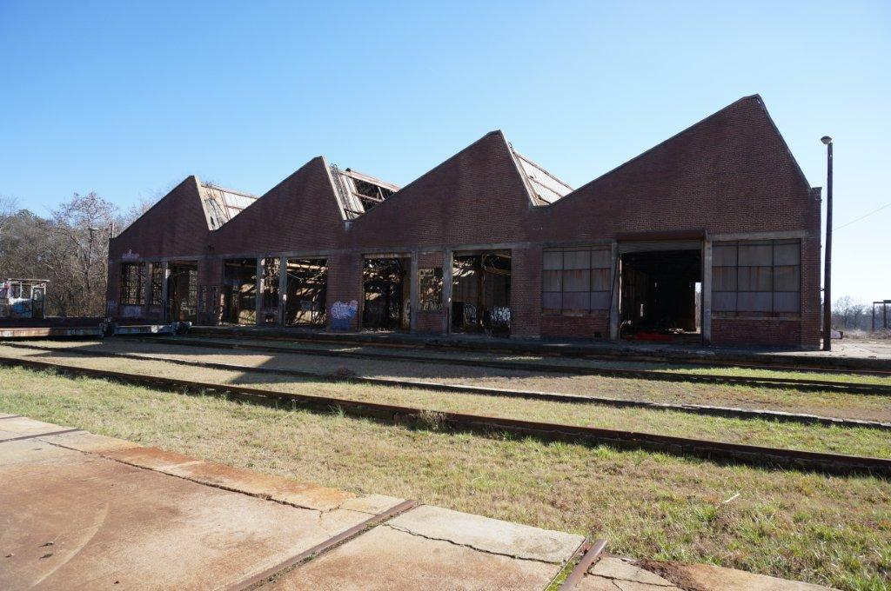
ContactPoint at Pullman Yard
that recycle the old…

Slide 17
ContactPoint at Pullman Yard
Pullman Yard means… achieving multiple benefits
Land Conservation | Historic Preservation
Sustainability | Alternative Transportation
Community Building | Job Creation
Education | Cultural Enrichment
Sports | Nutrition | Public Health

Slide 18
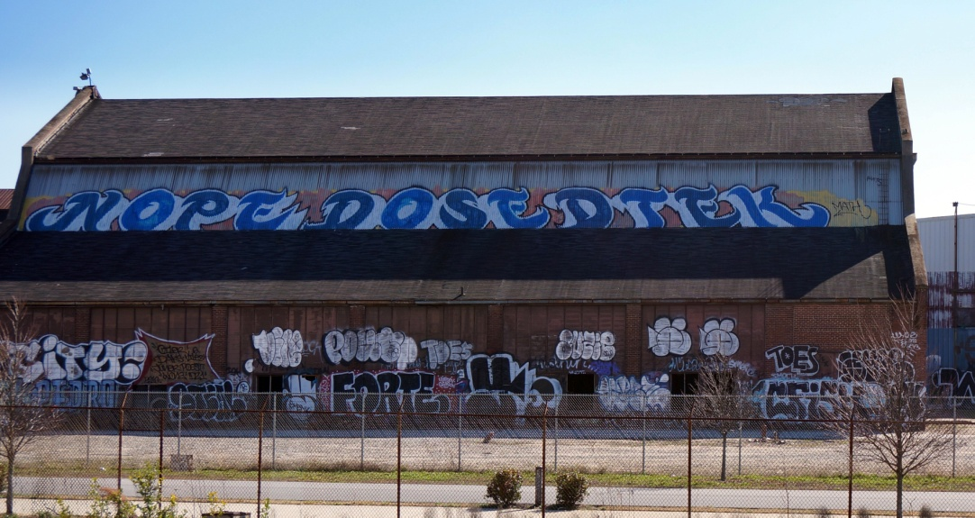
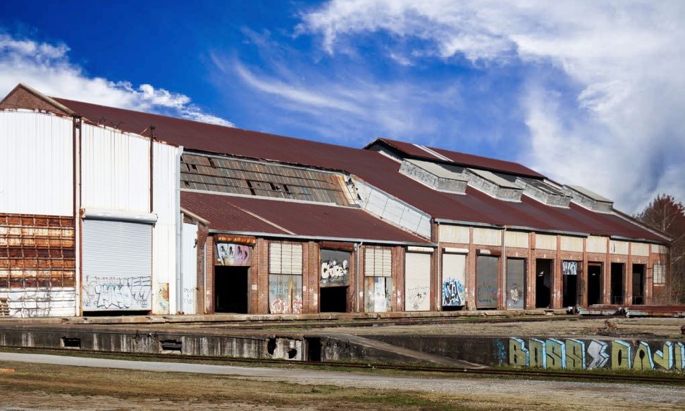
How We Do It
ContactPoint at Pullman Yard means …

Slide 19
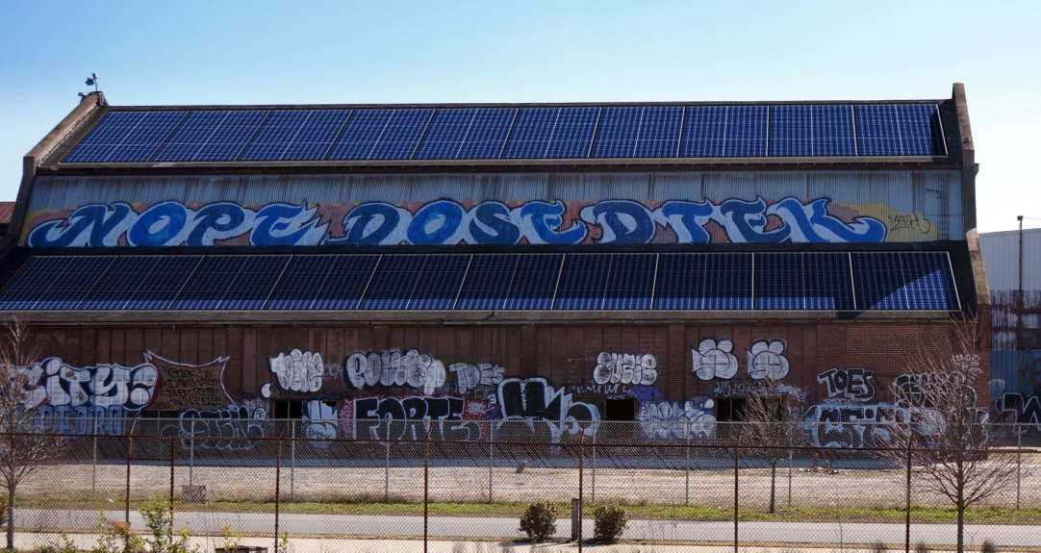
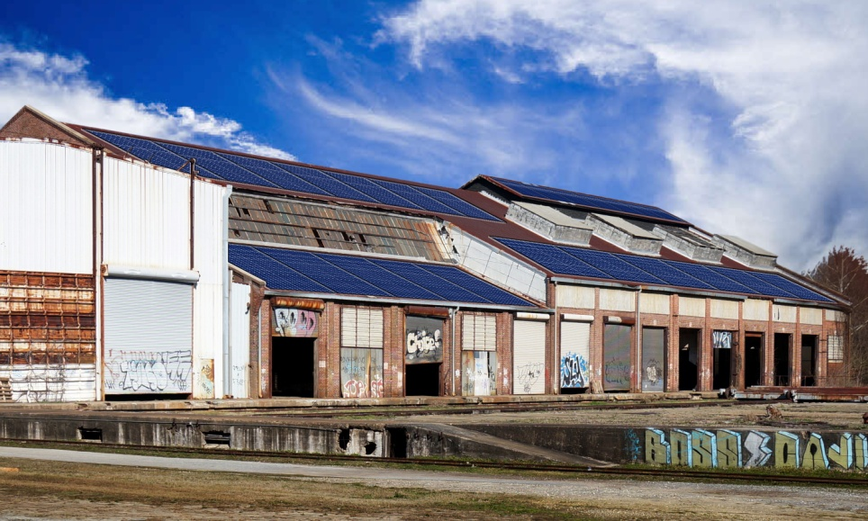
How We Do It
ContactPoint at Pullman Yard means … sustainability

Slide 20
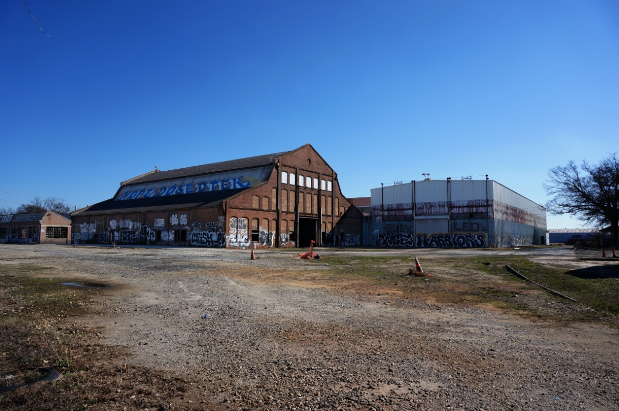
How We Do It
ContactPoint at Pullman Yard means …

Slide 21
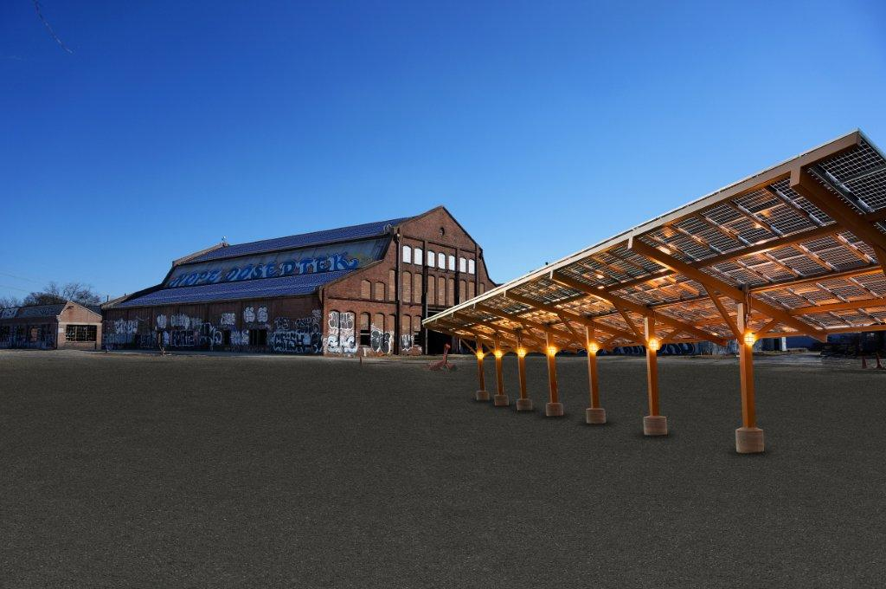
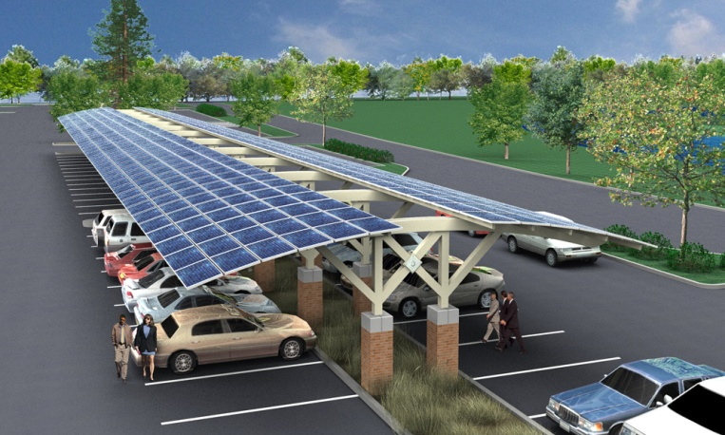
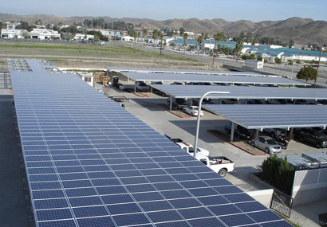
How We Do It
ContactPoint at Pullman Yard means … innovation

Slide 22
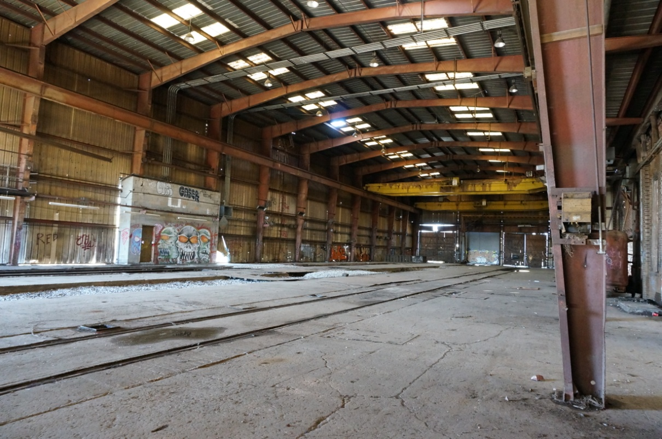
How We Do It
ContactPoint at Pullman Yard means …

Slide 23
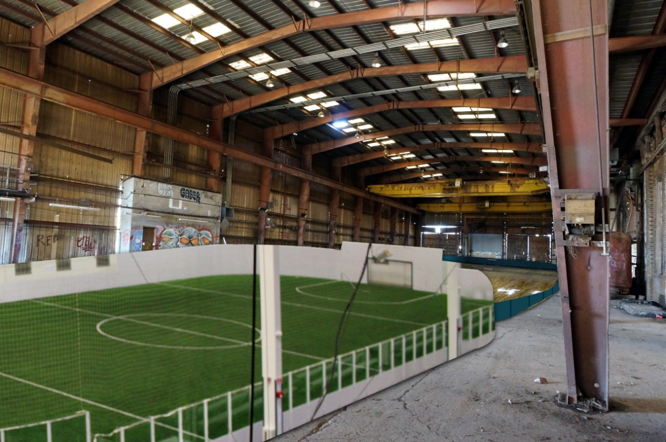
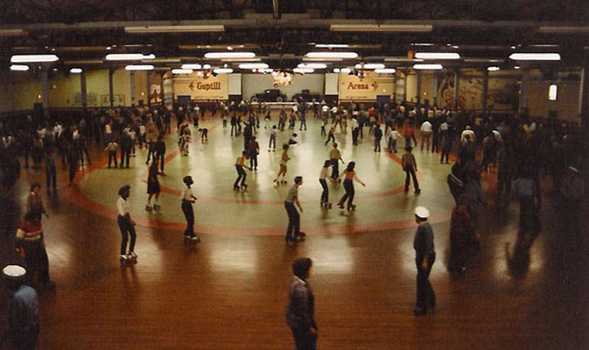
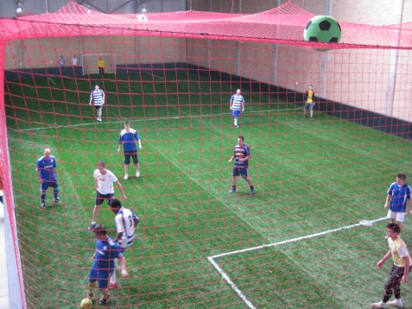
How We Do It
ContactPoint at Pullman Yard means … re-purposing with care

Slide 24
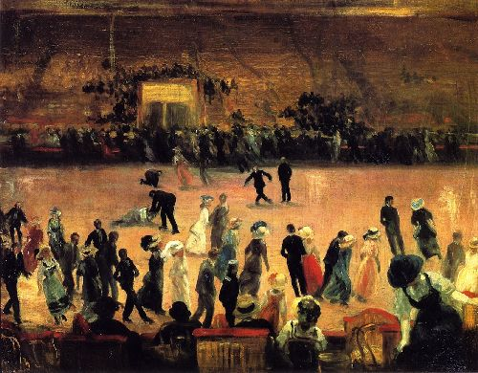
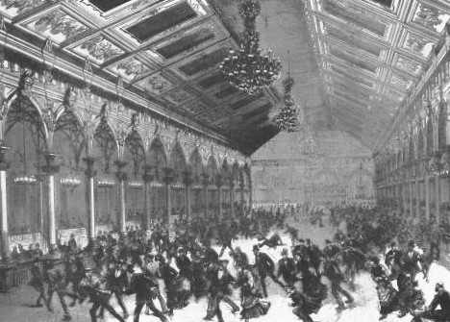
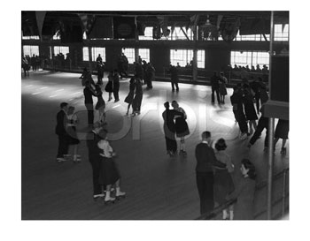
How We Do It
ContactPoint at Pullman Yard means reconnecting with values

Slide 25
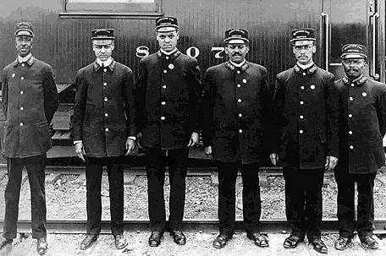
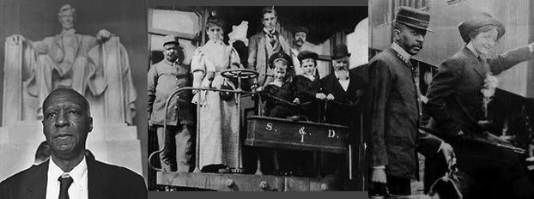
How We Do It
ContactPoint at Pullman Yard means reconnecting with history

Slide 26
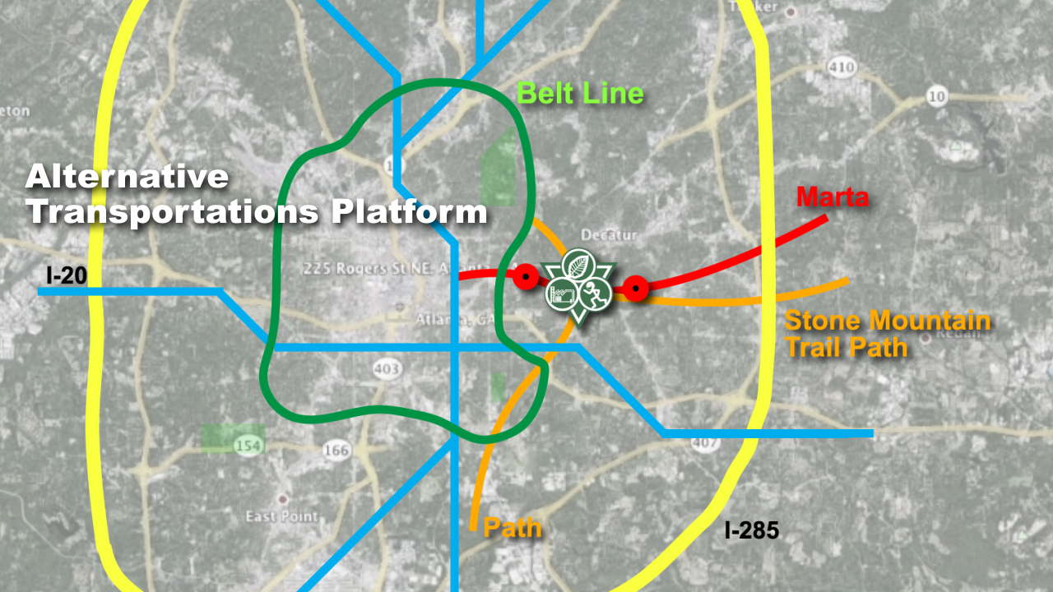
How We Do It
ContactPoint at Pullman Yard means smart transportation platform

Slide 27
How We Do It
ContactPoint at Pullman Yard means collaborations
Nutrition Arts & Education
Georgia Organics Emory University
Healthy Kids GA The Montessori School
Strong 4 Life ETIKA
Children’s Healthcare of Atlanta Conditioned Minds
Moore Farms Mythic Imagination Institute
Sevananda Academy of the Oaks
Whole Foods Re-Generation Initiative

Slide 28
How We Do It
ContactPoint at Pullman Yard means collaborations
Environment Sports
Georgia Trust for Historic Preservation Soccer in the Streets
The Trust for Public Land Atlanta Sport and Social Club
Environmental Conservation Group Atlanta Street Hockey
Atlanta BeltLine Atlanta Silverbacks
Marta Atlanta Hawks
Path Decatur Rec
Bioponica BlazeSport America
Ecovie Project SLIDE

Slide 29
How We Do It
Our non-profit will host versatile programming both day and night. This will allow us to create revenue while also addressing unmet social needs in the Kirkwood area.
100% of our proceeds will go directly to running the day-to-day operations of ACP and toward our mission of supporting the community with other like-minded initiatives.

Slide 30
What’s Next
In May, ACP submits its formal proposal to the Georgia Building Authority in an effort to acquire the Pullman Yard property.
We welcome everyone – individuals, families, businesses, organizations, schools, clubs, and foundations – to join us in our efforts to transform this vision into a reality.
Please contact davide@atlcp.org or nicv@atlcp.org
for more information or visit our website at www.atlcp.org.

