Slide 1
Atlanta ContactPoint Empowering you to play
Presentation
NOVEMBER 2013
www.atlcp.org

Slide 2
ENVIRONMENT | The Background
growing problems of
inactivity
virtual play
poor nutrition
information overload
superficial connection
insufficient green space

Slide 3
ENVIRONMENT | The Background
with a need to increase
physical activity rates
community education initiatives
access to green space
a sense of social & environmental responsibility
team-building efforts
capacity development & communications skills

Slide 4
Who We Are
Atlanta ContactPoint (ACP) is a Georgia 501(c)(3) non­profit organization established in 2012 to engage children and adults through the power of play.
Our mission is to create community-based models to support, educate, and facilitate comprehensive education and wellness programs that encompass sports, fitness, arts, nutrition, education, and social/environmental responsibility.

Slide 5
What We Do
PlayDay
The Pullman Yard Project

Slide 6
What We Do
PlayDay
A series of events which offer communities a free day to enjoy various sports, fitness, arts, nutrition and social awareness based programs. Play Day is the mobile version of our Pullman Yard model.
Pullman Yard
An indoor and outdoor community-based recreation space and trans-disciplinary center where children and adults of all socio-economic backgrounds will come together to play, learn, and connect.

Slide 7
What We Do
PlayDay We utilize existing city parks to bring together local neighborhoods and to promote their facilities, organizations, initiatives, and local coaches through the power of play.
PlayDay also engages participants in health initiatives, educating them on the importance of nutritious eating and environmental/social responsibility

Slide 8
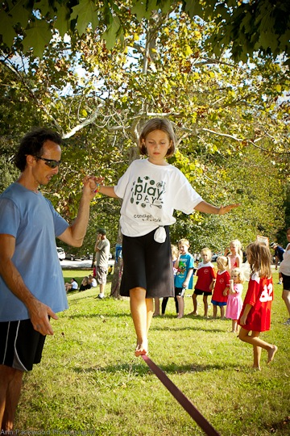
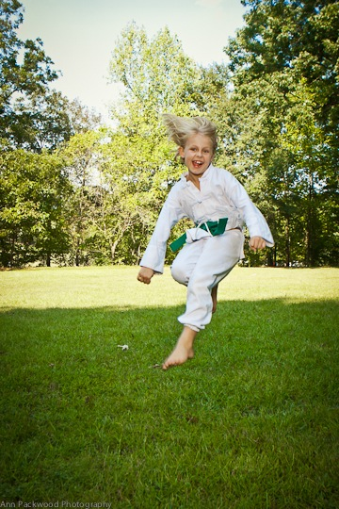
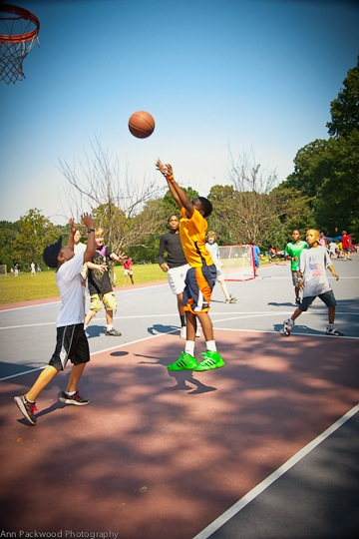
PlayDay Happiness

Slide 9
Play Day Health

Slide 10
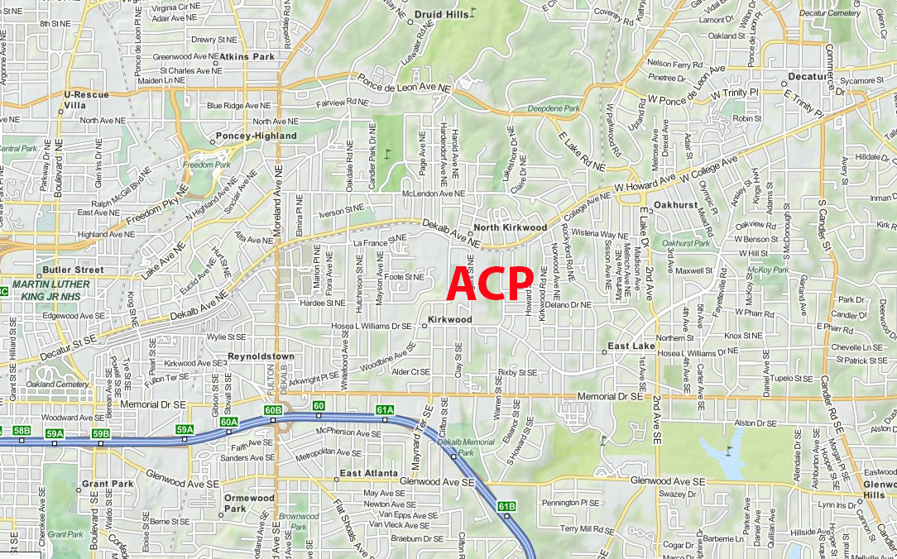
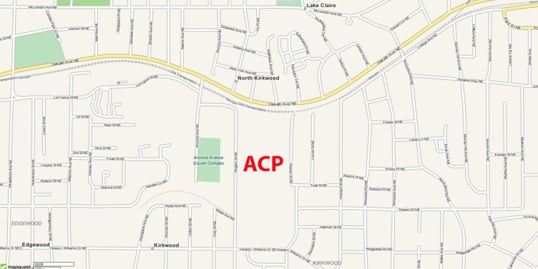
ContactPoint at Pullman Yard
Pullman Yard is a vacant 26-acre historic train yard that houses150,000 sq feet of buildings and is strategically located in the heart of Kirkwood, between Downtown Atlanta and the City of Decatur.

Slide 11
ContactPoint at Pullman Yard
Pullman Yard means… achieving multiple benefits
Land Conservation | Historic Preservation
Sustainability | Alternative Transportation
Community Building | Job Creation
Education | Cultural Enrichment
Sports | Nutrition | Public Health

Slide 12
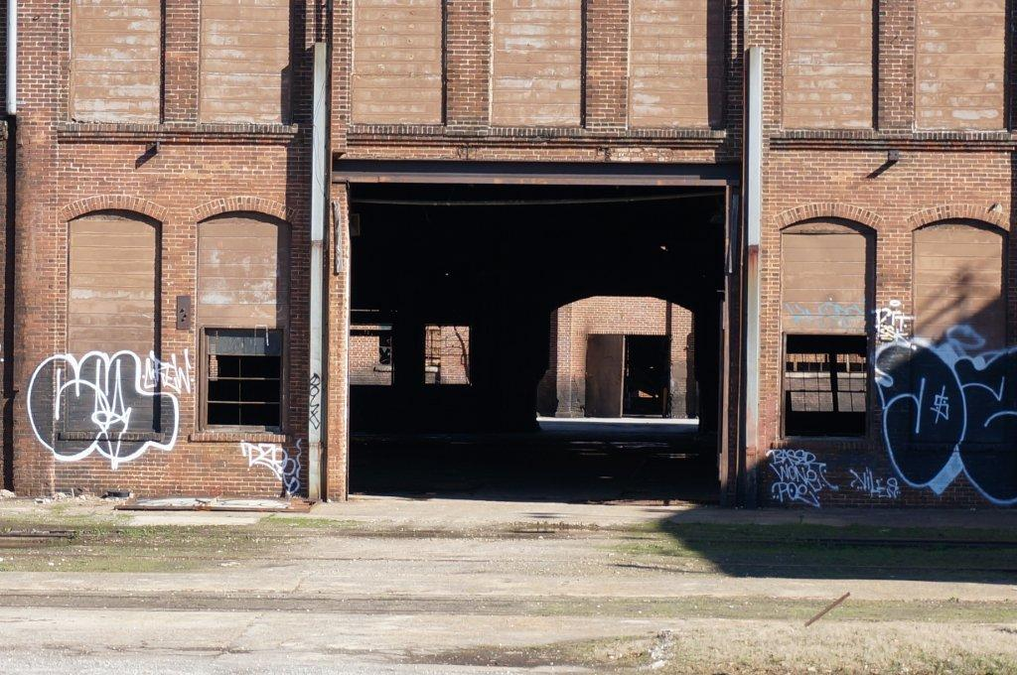
ContactPoint at Pullman Yard
Pullman Yard means … envisioning the potential

Slide 13
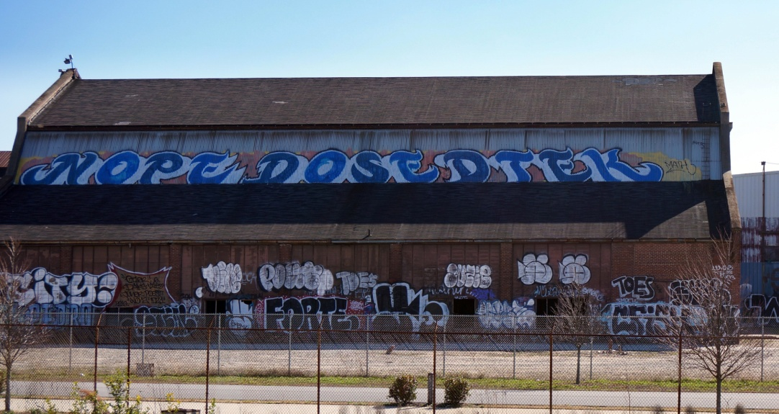
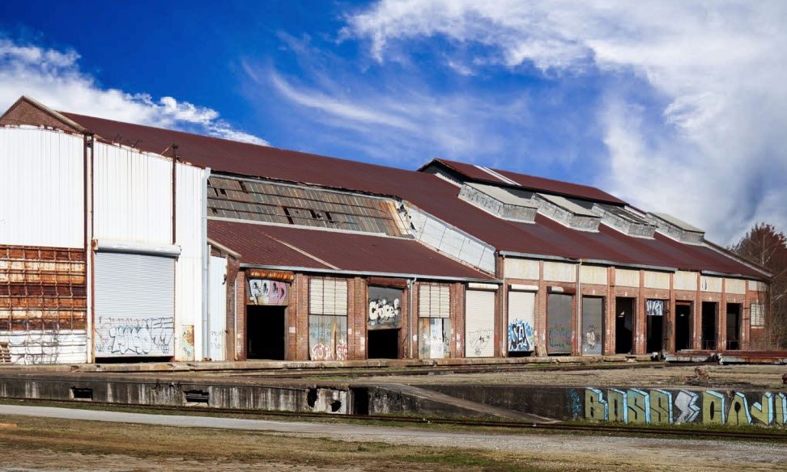
How We Do It
ContactPoint at Pullman Yard means …

Slide 14
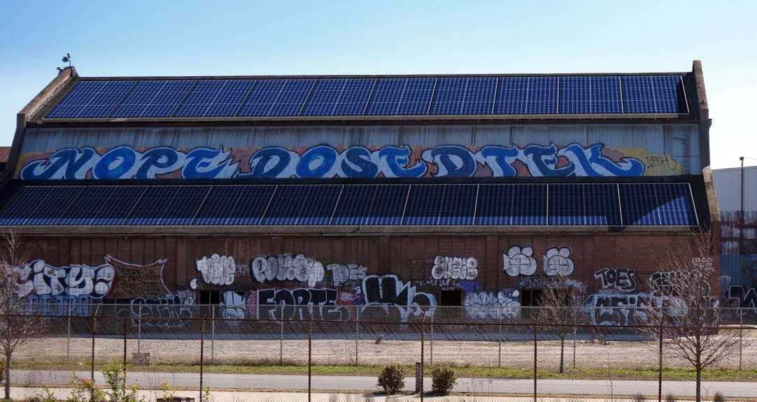
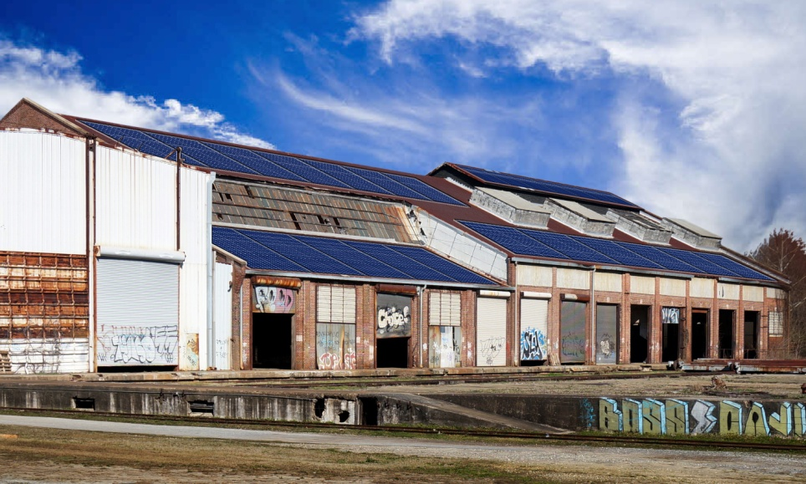
How We Do It
ContactPoint at Pullman Yard means … sustainability

Slide 15
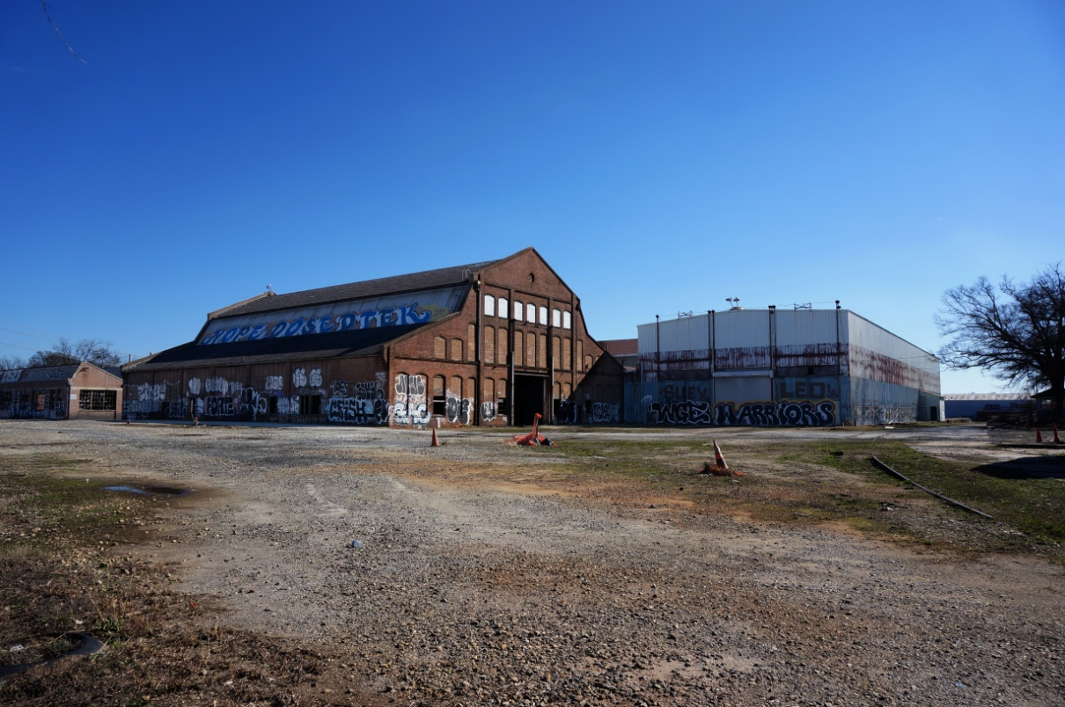
How We Do It
ContactPoint at Pullman Yard means …

Slide 16
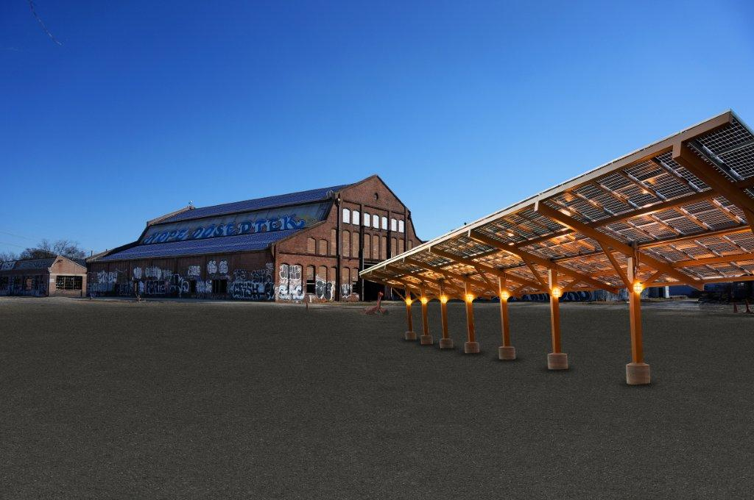
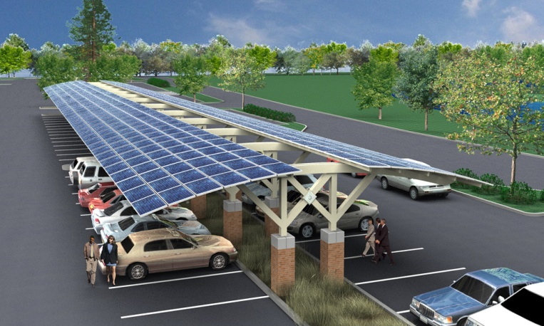
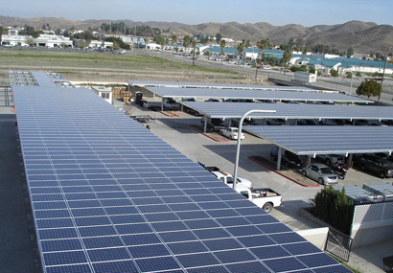
How We Do It
ContactPoint at Pullman Yard means … innovation

Slide 17
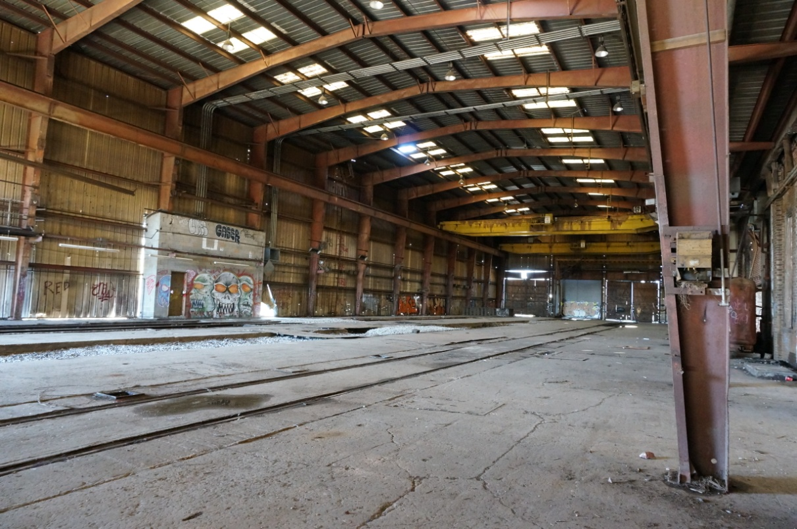
How We Do It
ContactPoint at Pullman Yard means …

Slide 18
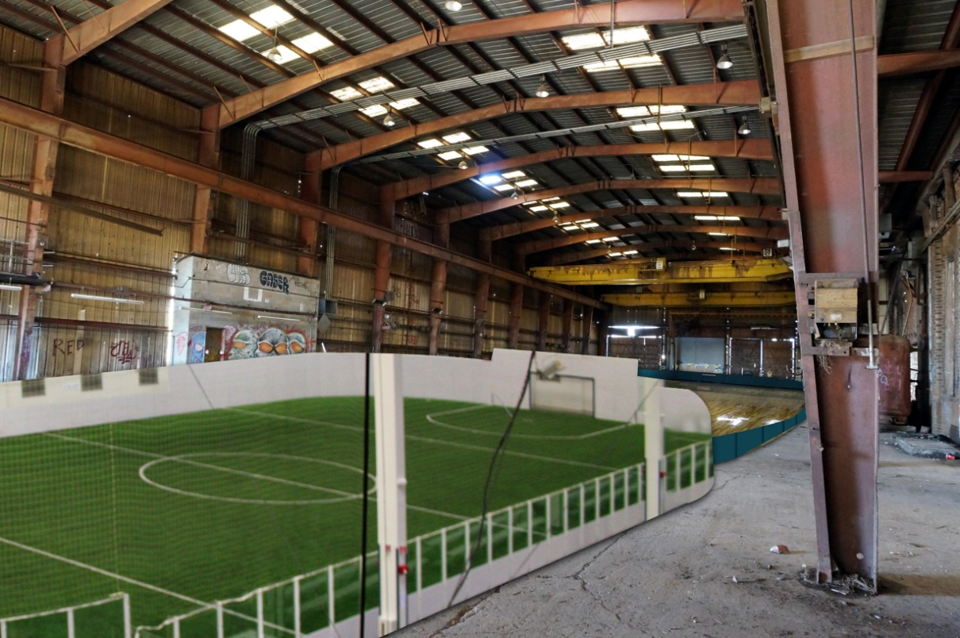
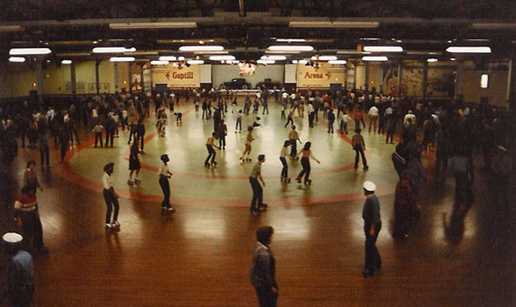
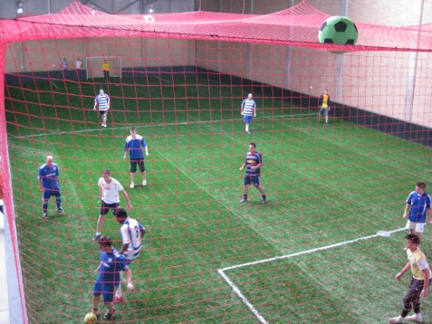
How We Do It
ContactPoint at Pullman Yard means … re-purposing with care

Slide 19
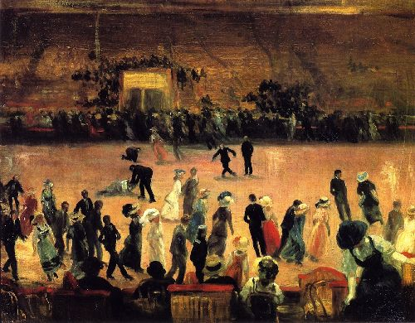
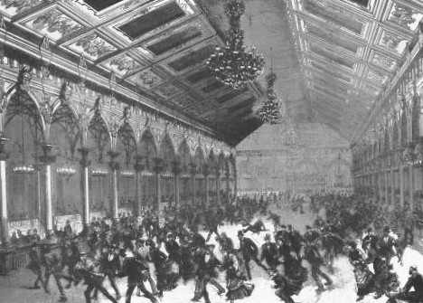
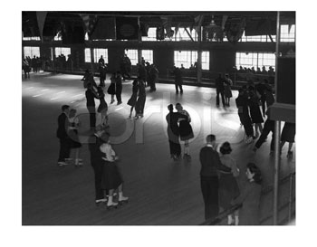
How We Do It
ContactPoint at Pullman Yard means reconnecting with values

Slide 20
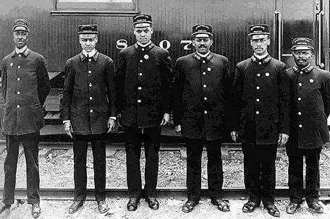
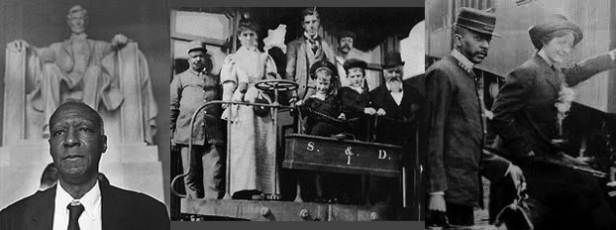
How We Do It
ContactPoint at Pullman Yard means reconnecting with history

Slide 21
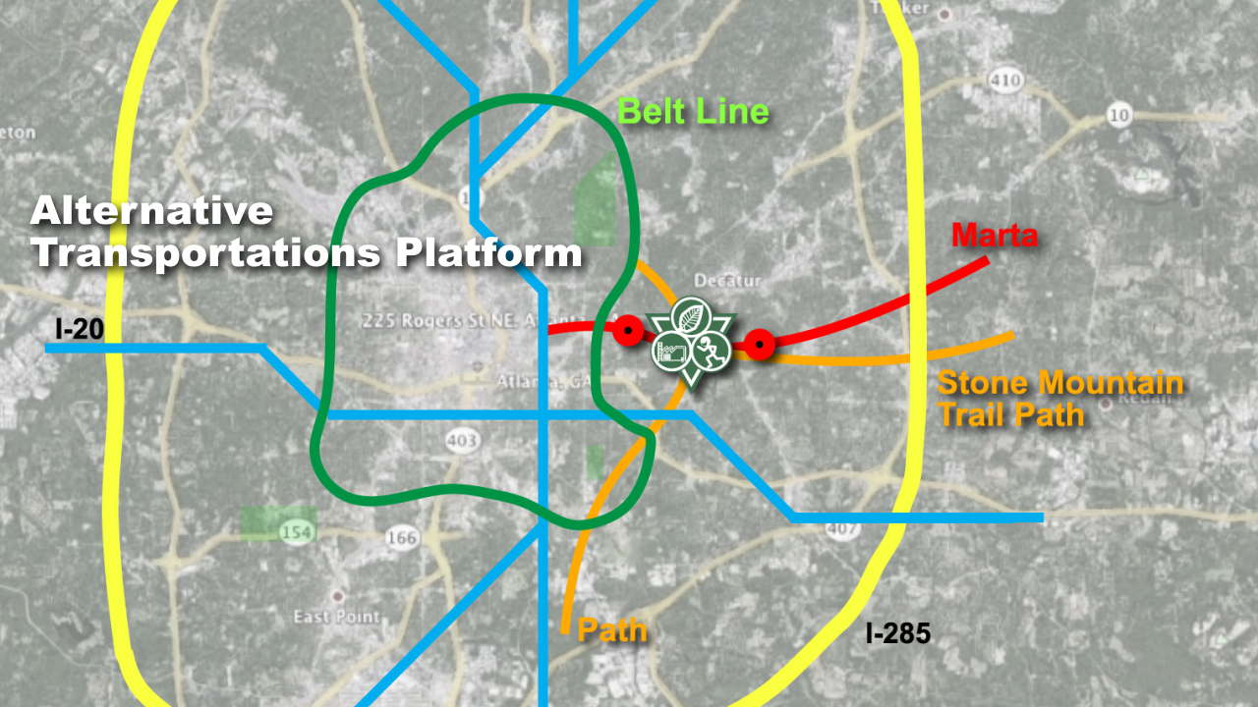
How We Do It
ContactPoint at Pullman Yard means smart transportation platform

Slide 22
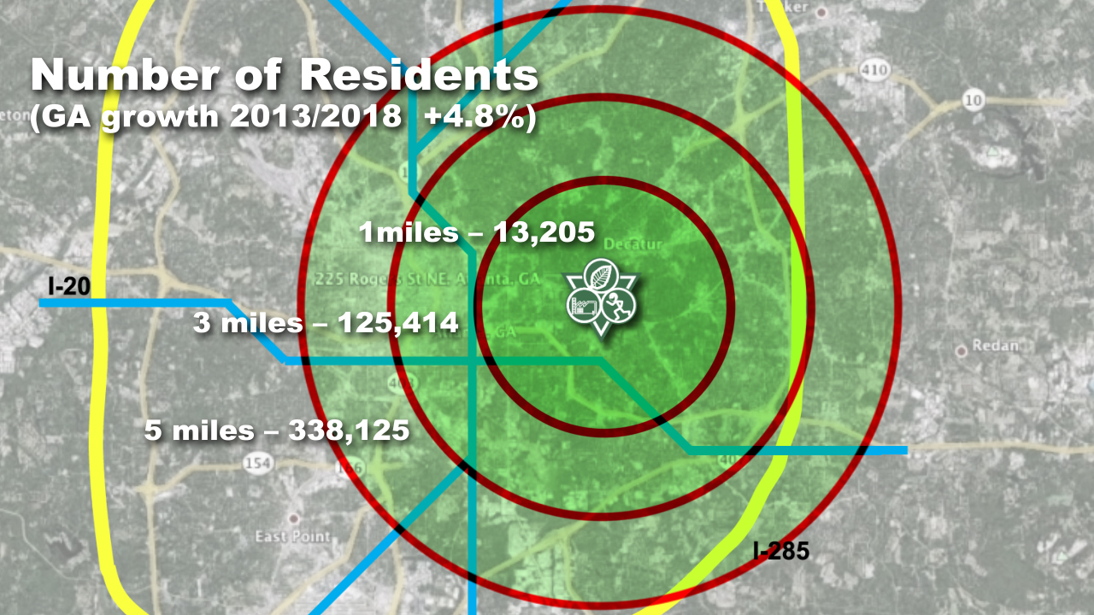
How We Do It
ContactPoint at Pullman Yard means a solid business plan, and a smart city development model also elsewhere reproducible.

Slide 23
How We Do It
Our non-profit will host versatile programming both day and night. This will allow us to create revenue while also addressing unmet social needs in the Kirkwood area.
100% of our proceeds will go directly to running the day-to-day operations of ACP and toward our mission of supporting the community with other like-minded initiatives.

Slide 24
Partnerships
Atlanta ContactPoint means collaborations.
We have established 5 Partnerships Levels
Executive Partnerships
Core Partnerships
Programming Partnerships
Community Partnerships
Infrastructure Partnerships

Slide 25
Partnerships
Executive Partnership – Project Integration & Development
ETIKA is a Georgia-based 501(c)(3) nonprofit organization that bridges public scholarship, the arts and the business worlds. ETIKA puts humanity at the center, designing and implementing trans-disciplinary initiatives that stimulates conscious communication and transformation, moving people from passive consumers of information and knowledge into active co-creators of new ways of thinking and being. More info at www.etikacenter.com

Slide 26
Partnerships
Core Partnerships
BLAZE SPORTS AMERICA – BlazeSports is driven by a desire to provide all children and adults with physical disabilities the chance to play sports and live healthy, active lives. http://www.blazesports.org
ATLANTA SPORTS & SOCIAL CLUB – offering adult co-ed sports leagues and social events around Atlanta. http://atlantasportandsocialclub.com
ACADEME of the OAKS HIGH SCHOOL – providing a unique learning opportunity by combining experience-based developmental learning with formal academic disciplines. http://www.academeatlanta.org
SOCCER ON THE STREET – All kids deserve a chance for success. Soccer in the Streets empowers kids who lack opportunity by using soccer as a medium to make them employable adults. http://www.soccerstreets.org

Slide 27
Partnerships
Core Partnerships
CIRCUS CAMP – offering an exciting form of physical and mental training that combines therapeutic principles with the skill and dexterity of circus arts. http://www.circuscamp.org
TRUE LACROSSE - is one of the most fast growing sport discipline in the USA. www.ga.truelacrosse.com
KILPATRICK, TOWNSEND AND STOCKTON - Offers a full range of business, finance and government regulatory legal services, http://www.kilpatricktownsend.com
We are currently seeking Core Relationships in the following disciplines:
nutrition/food
project finance
energy conservation/green production

Slide 28
Partnerships
Development Partnerships
LORD, AECK, AND SARGENT
OBRIEN AND GERE
LEE MORGAN DEVELOPMENT
VISIONEERING INTERNATIONAL
BROADWALK CAPITAL MANAGEMENT
PARALINE ARCHITECTS
THE ATLANTA HAWKS

Slide 29
Partnerships
Programming Partnerships
THE WALDORF SCHOOL OF ATLANTA
CONDITIONED MINDS
COLLEGIATE CONSULTING
WELLCOM
EMORY UNIVERSITY
ATLANTA HOCKEY
DECATUR REC
DECATUR BASEBALL CLUB
ULTIMATE FRESBEE ASSOCIATION
OUTDOOR REC ADVENTURES
ATLANTA YOUTH RUGBY
WANDERBUS
MYTHIC IMAGINATION INSTITUTE

Slide 30
Partnerships
Infrastructure and Community Partnerships
MARTA
THE BELTLINE
PATH FOUNDATION
ATLANTA BIKE COALITION
CITY OF ATLANTA PARKS DIVISION
KIRKWOOD HOME OWNER ASSOCIATION
CANDLER PARK NEGHBORWOOD ASSOCIATION
PARK PRIDE
ATLANTA STREETS ALIVE
MIDSUMMER MUSIC FESTIVAL
TRUST FOR PUBLIC LAND
THE GEORGIA TRUST FOR PUBLIC LAND
THE GEORGIA TRUST FOR HISTROIC PRESERVATION
DRUID HILLS UNITED METHODIST PRESCHOOL
… and more

Slide 31
Partnerships
MORE Programming Partnerships, also PLAYDAY
Bessie Branham Rec Center Dicks Sporting Goods
Coan Park Rec Center Circus Camp
Grant Park Rec Center Eagle Essence Dancers
Park Pride KTX Fitness
Atlanta Hawks Soccer in the Streets
Atlanta Braves Top of the Key
Atlanta Sport and Social Club The Pitchers Mound
Atlanta Youth Rugby Children’s Healthcare Atl
Atlanta Gaelic Assoc Atlanta Bike Polo
Northside UM Rec Center AYSA
Good Moves Dance Blaze Sports
Café of Life Condition Kettle bell
Community Farmers Markets Moore Farms
Vance Exley Tennis Decatur Rec
Pure Tennis SlackLine Atlanta
Crossfit Atlanta Intown

Slide 32
Executed Calendar 2013 main events
March Play Day at Bessie Park
April Play Day at Coan Park
April Play Day at Grant Park
May Participation at Atlanta Street Alive
June 5K Run, in collaboration w/MidSummer Festival
June Participation at Recycle and Sustainability Day
Aug Play Day at Langford Park
Sept Play Day at Candler Park and 5K
Sept Participation at Atlanta Street Alive
Sept Participation at the 5K, Beltline Running Series
Oct Play Day at the Beltline
Oct Participation at Atlanta Street Alive
Oct PlayaThon with Inman Middle school
Oct Play Day at Piedmont PARK
Nov Participation at King of the Pops Event

